Slide 1
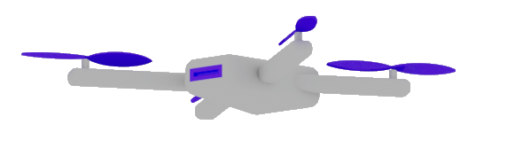

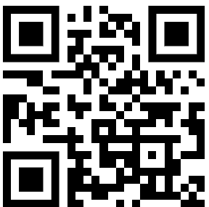
Die neue Software Ära hat begonnen
Dr. Damir Dobric
Lead Software Architect daenet GmbH / ACP Digital
Microsoft Regional Director,
Most Valuable Professional: AI

Slide 2
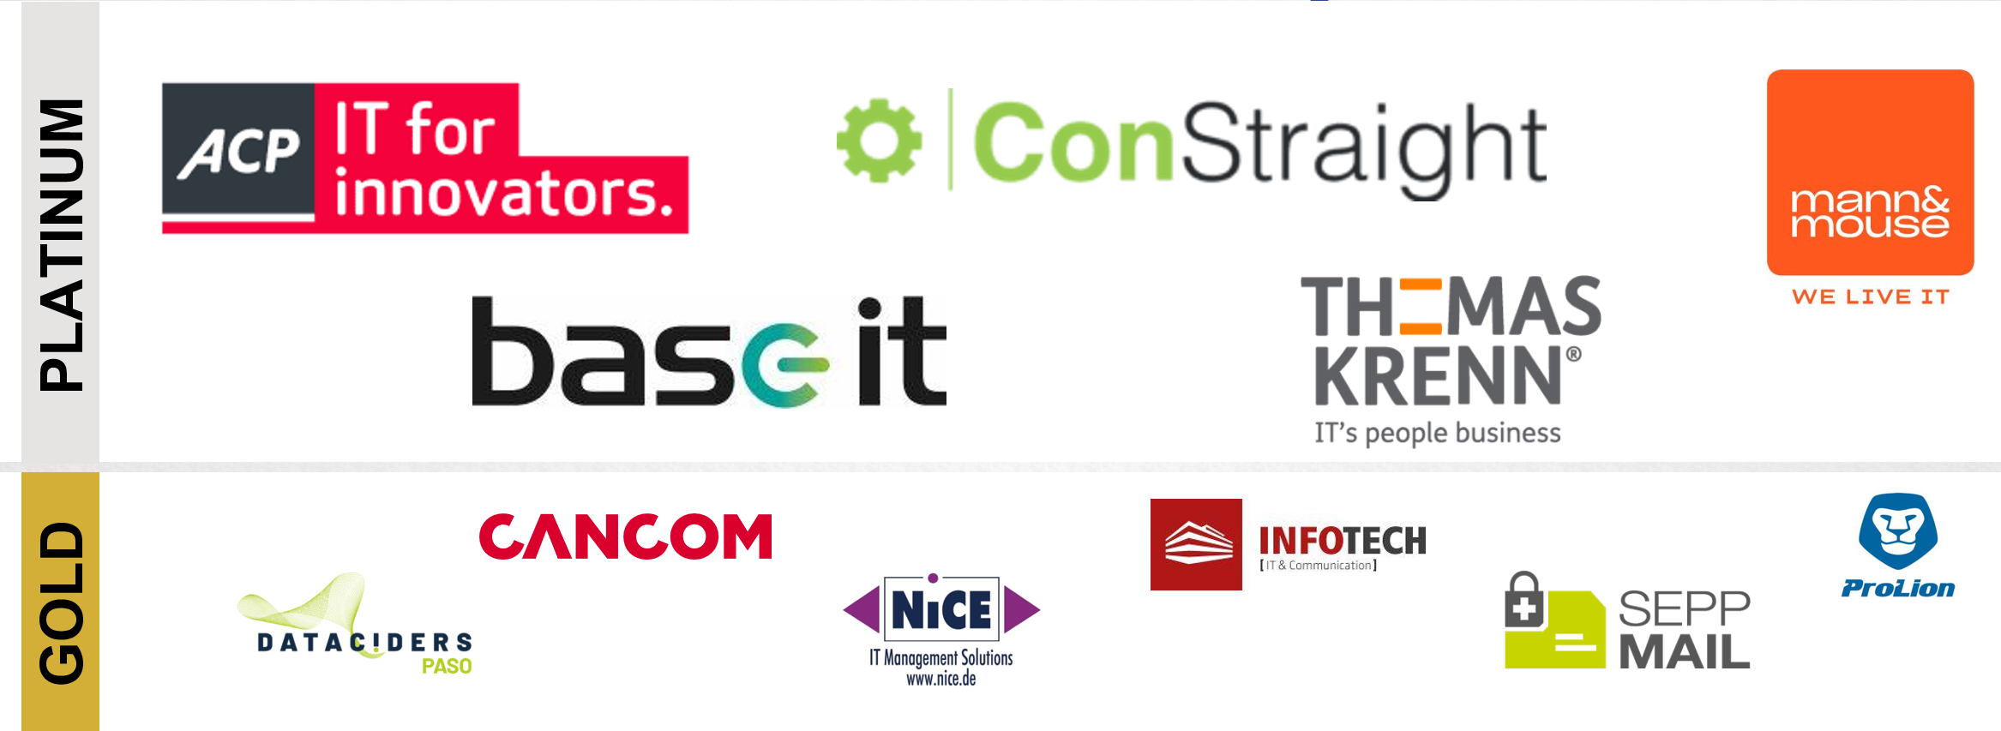
DANKE AN UNSERE SPONSOREN

Slide 3
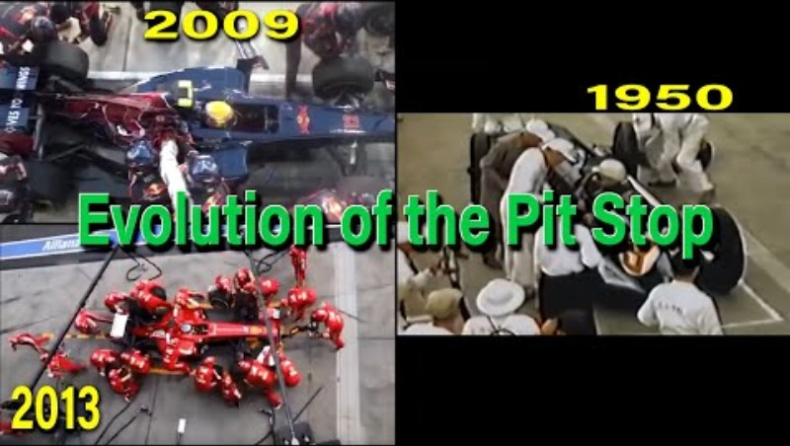
F1 Pitstop 1950 vs 2009 vs 2013

Slide 4
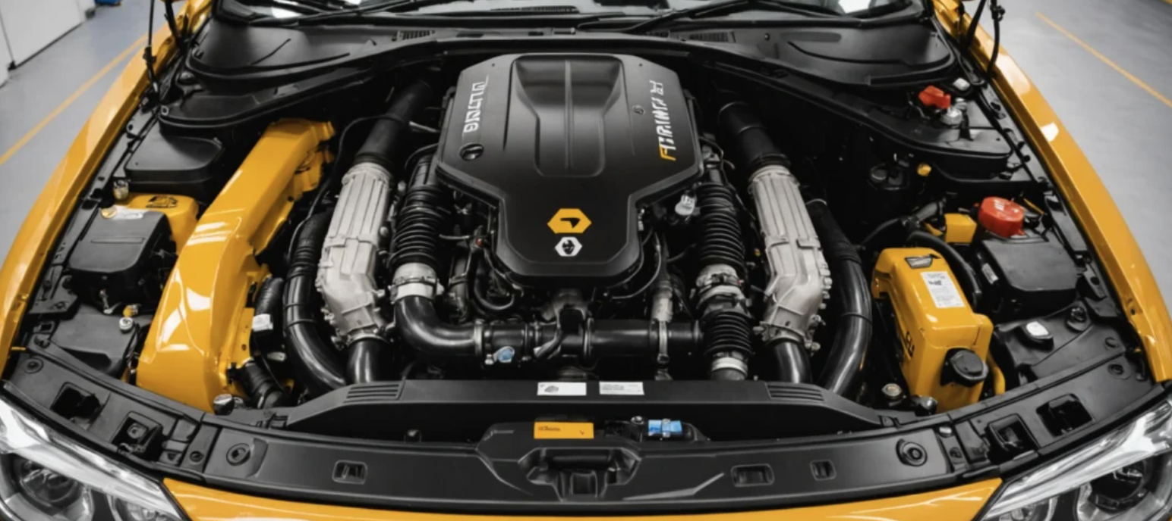
MODEL
TOKENS
AGENT
EMBEDDINGS
R A G

Slide 5

Software V2
The new Generation of Software
“After tomorrow”
“Tomorrow”
Quantum Computing
Software
?
Today
AI & Large Language Model Integration
Syntax Driven Languages

Slide 6
DEMO Symbiose: Mensch und Maschine Der Admin und die CommandLine-Console

Slide 7
TOKENS

Slide 8

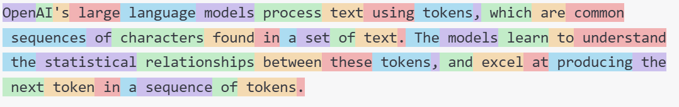
What are Tokens?
1 token ~= 4 chars in English
1 token ~= ¾ words
100 tokens ~= 75 words
Byte Pare Encoding (Gage,1994): Wikipedia
What are tokens and how to count them?
Token Pricing: Pricing (openai.com)

Slide 9
EMBEDDINGS

Slide 10
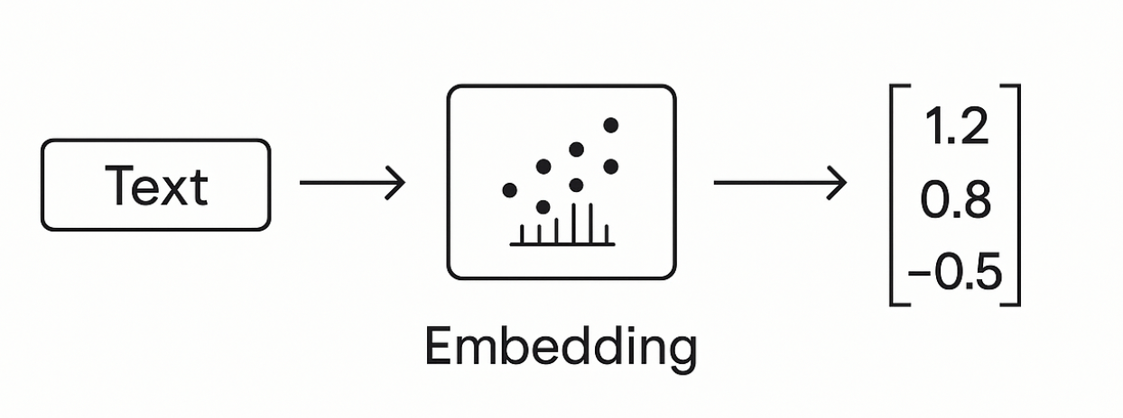
Embeddings
Making a vector from text

Slide 11
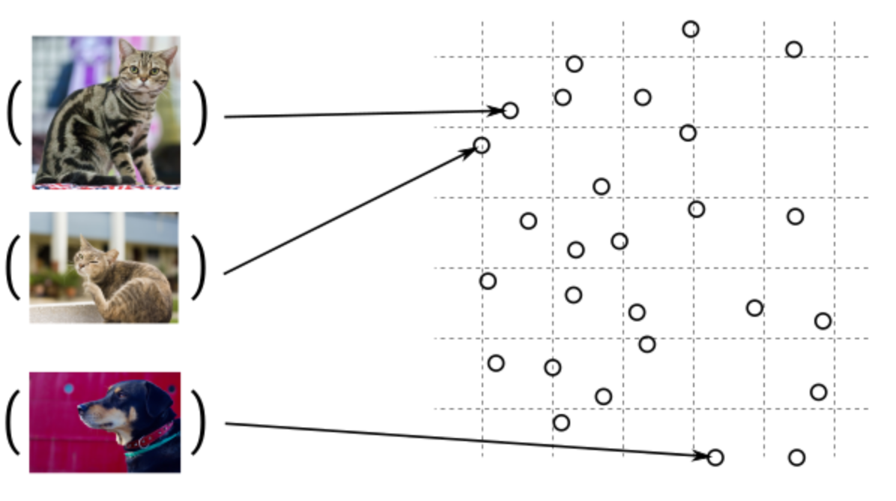
Guess, today is a nice day in Palma
Embedding Models
Today is a typical German rainy day
Two things are infinite: the universe and human stupidity; and I'm not sure about the universe.

Slide 12
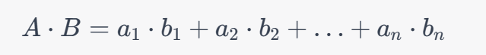
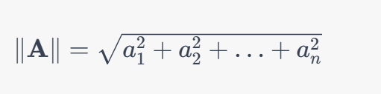
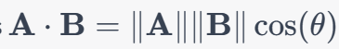
Similarity Between Multidimensional Vectors
Dot Product
The Norm
Cosine Similarity

Slide 13
DEMO

Slide 14
When to use Embeddings?
Semantic Search
Classification
Clustering
Recommendations
. . .

Slide 15
VECTOR DATABASES

Slide 16
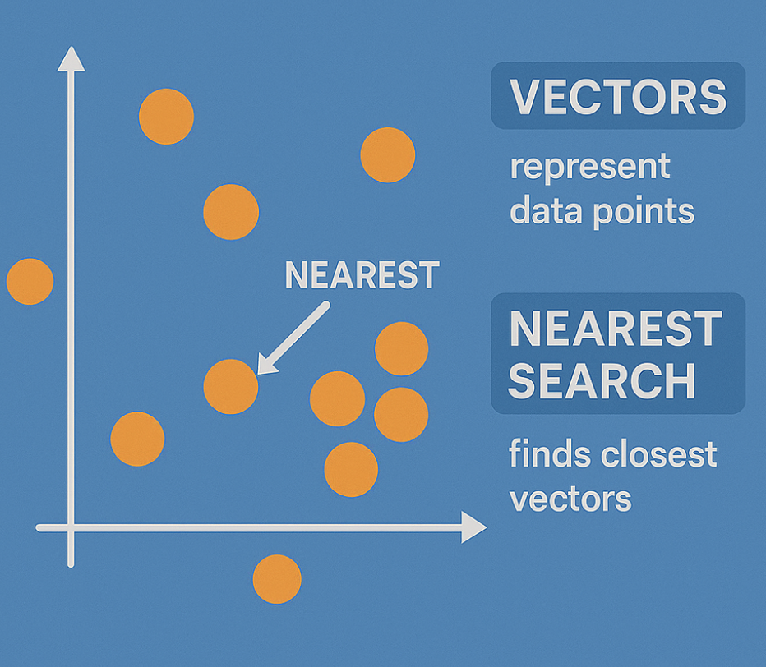
Embeddings in DATABASE

Slide 17
Vector DBs
SqlServer 2025 Native Vector Search
Quadrant
CosmosDB
…

Slide 18
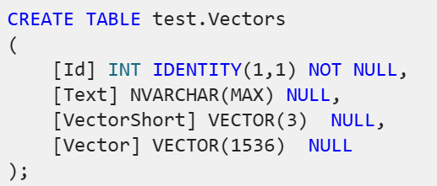
SqlServer 2025 Native Vector Search
SqlServer 2025 Native Vector Search
In Azure
On-Prem
SQL Server Native Vector Search for .NET Developers

Slide 19
DEMO
SQL Server Native Vector Search
SQL Server Native Vector
DECLARE @v1 VECTOR(2) = '[1,1]';
DECLARE @v2 VECTOR(2) = '[-1,-1]';
SELECT
VECTOR_DISTANCE('euclidean', @v1, @v2) AS euclidean,
VECTOR_DISTANCE('cosine', @v1, @v2) AS cosine,
VECTOR_DISTANCE('dot', @v1, @v2) AS negative_dot_product;

Slide 20
COMPLETION MODELS
How does all this work?

Slide 21
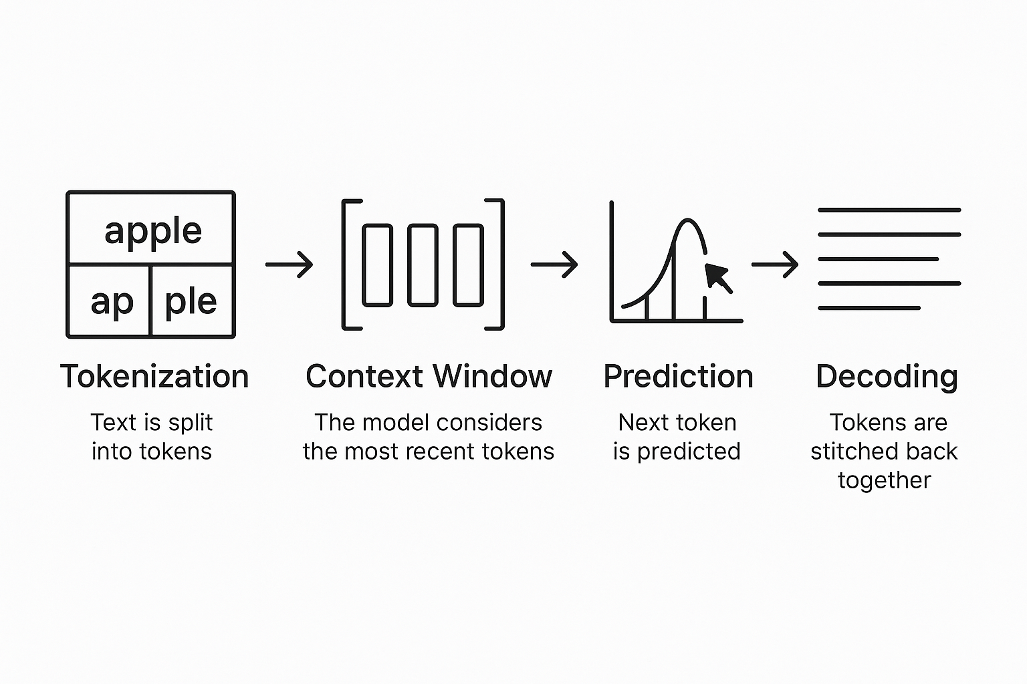
Completion Models
Text Completion Flow

Slide 22

DEMO
Probabilities under the hub

Slide 23
RAG Retrieval Augmented Generation

Slide 24
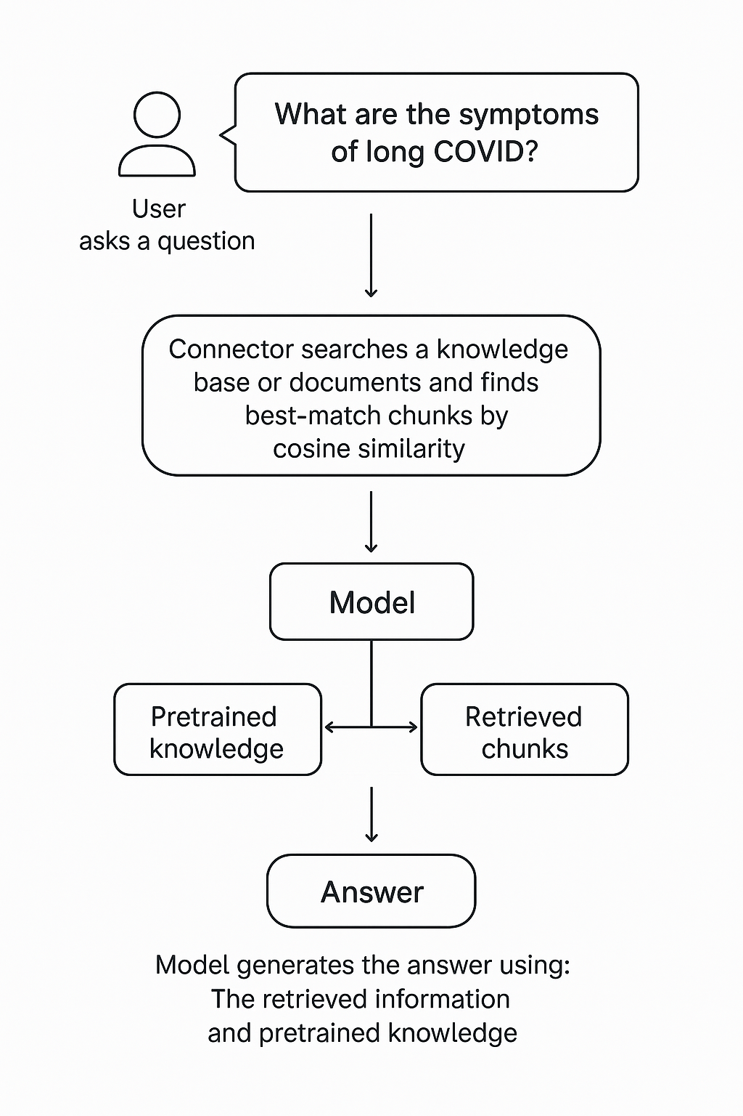
RAG Retrieval-Augmented Generation
Extending the model knowledge
Combines information retrieval with text generation
https://arxiv.org/abs/2005.11401

Slide 25
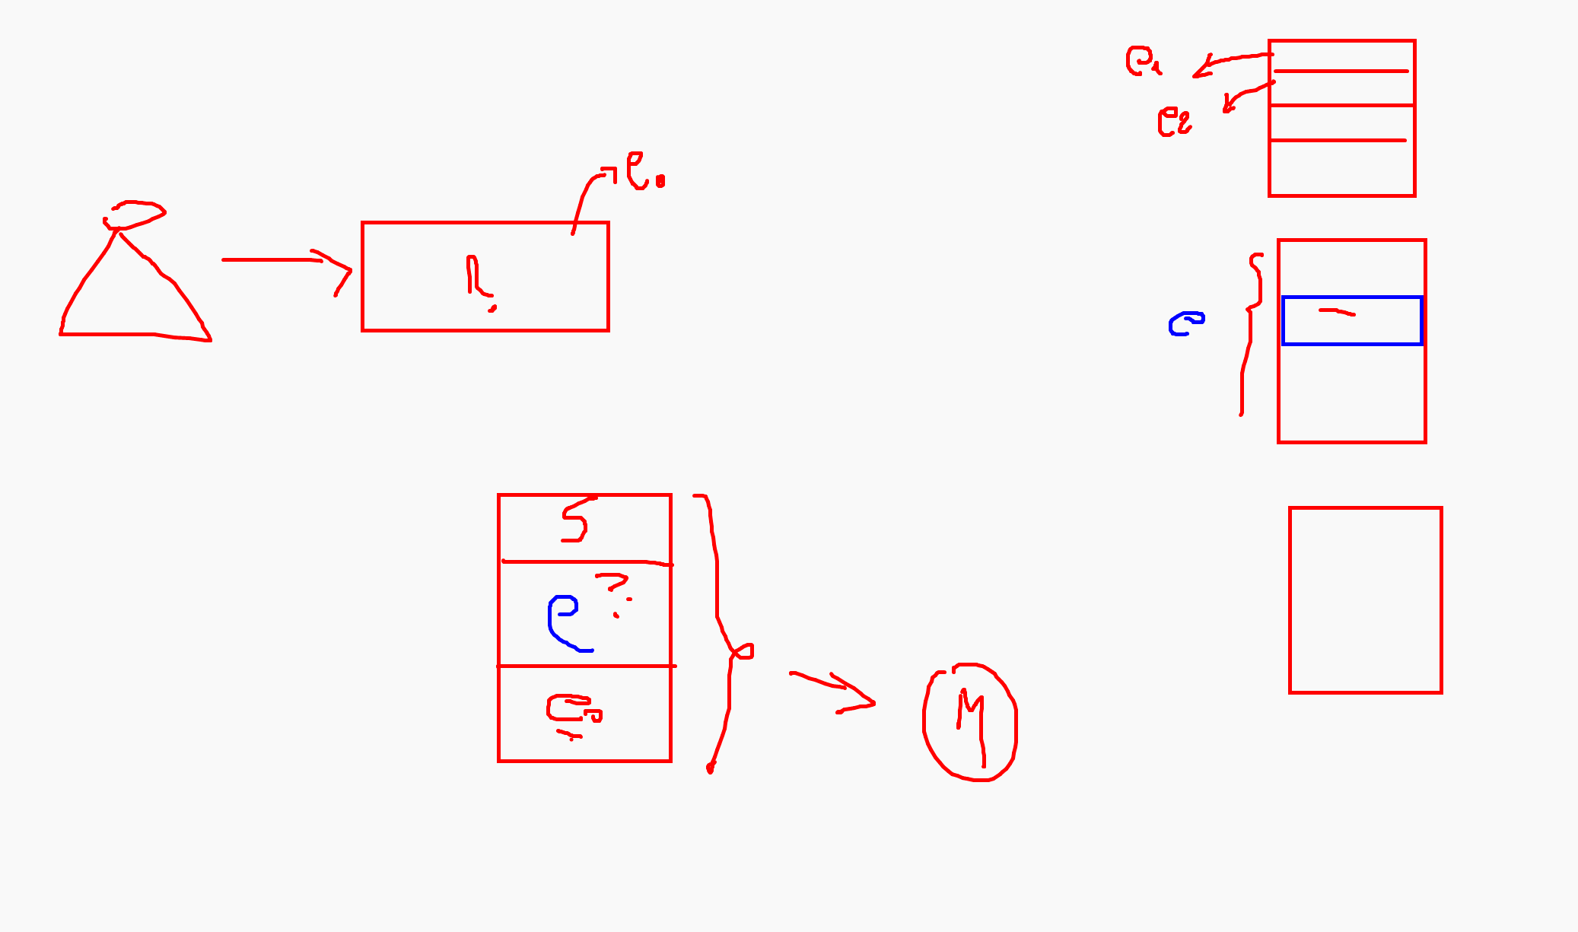

Slide 26
DEMO (c#)
Creating chunks
Creating embeddings
InMemory Vector DB
Calculating Similarity

Slide 27
Completions Chat Streaming TextToSpeech Look into the image Image Generation Image Edit Embeddings RunRetrievalAugmentedGenerationAsync();
OpenAI SDK

Slide 28


Model generiert Text
User: Hallo, wie geht es dir?
(1)
KI
Prompt
(2)
Agent: Mir geht es gut. Danke

Slide 29
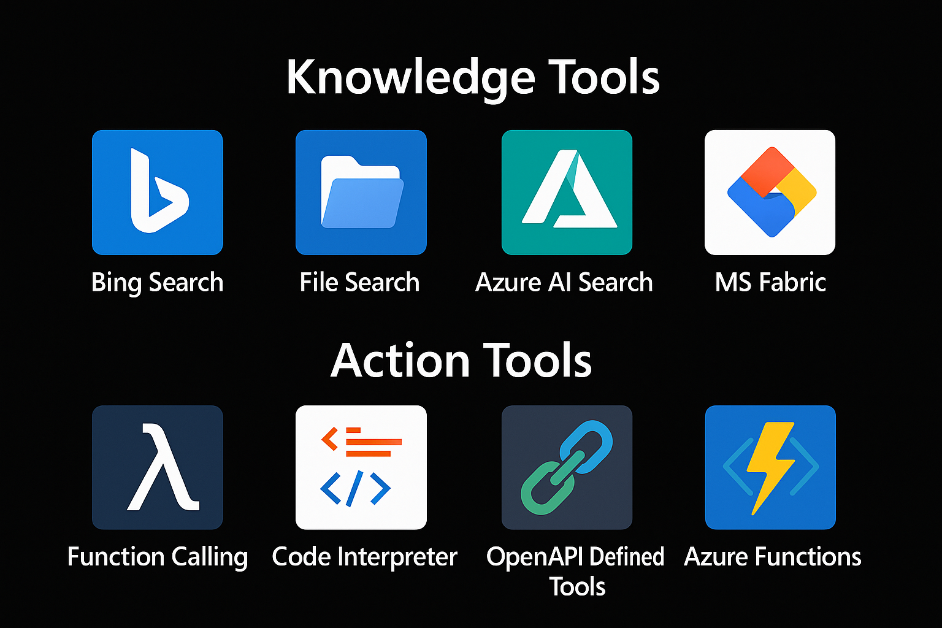

Extending Models
=> RAG
Tool 1
AGENT
=> Function Calling
Tool 2

Slide 30
Function Calling
Model wird zwei Mal angewendet:
1.Um Prompt auf Funktion zu mappen. (1)
2.Um die User Message zu generieren. (4) An Model werden die Daten weitergegeben, die Connector zur Verfügung stellt. Z.B. Licht ist an.
User: Schallte das Licht auf grün an?
(1)
AGENT
(1)
KI
PlugInLIbrary
(5)
(5)
(2)
Prompt
(3)
(4)
Agent:Licht ist an.
Licht Connector (API)
Tool: SchallteLichtAn(Grün)
Connector schalltet das Licht über Connector an

Slide 31

https://mcpservers.org/
Model Context Protocol
csharp-sdk/samples/AspNetCoreSseServer at main · modelcontextprotocol/csharp-sdk

Slide 32
Tools are inside MCP Servers
=> RAG
Tool 1
AGENT
MCP
=> Function Calling
Tool 2

Slide 33
Semantic Kernel is an open-source SDK that lets you easily combine Generative AI Models syntactic programming languages like C#, Python an JAVA.
Currently supported languages: C#, Python
Currently supported AI Services: OpenAI, Azure OpenAI, and Hugging Face
Introduction | 🦜️🔗 Langchain

Slide 34
DEMO Die Beziehung zwischen Menschen und der Lampe.

Slide 35
Process Orchestration
Tool 1
AGENT
Tool 2
Tool N

Slide 36
DEMO Vibe Coding

Slide 37
Microsoft confidential

